Slide 1

Classifying URLs A Machine Learning Approach
Author: Helga Wilde

Slide 2
Outline
Background
Project Approach & Goals
Data & Feature Creation
Exploratory Data Analysis
Inferential Statistics
Machine Learning

Slide 3
Background

Slide 4
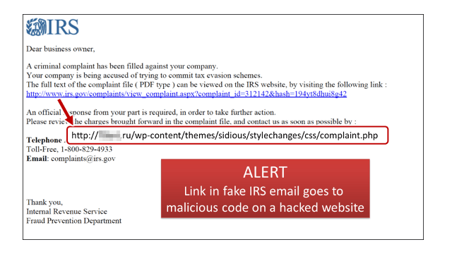
Malicious web content remains a key resource leveraged by threat actors

Slide 5

Identification of malicious urls
…a key capability for many security tools, using:
1. Blacklists
2. Real-Time Evaluation
Infrastructure reputation
URL source code
Client/server communication
Client system changes

Slide 6
Problems with URL identification
Heavy reliance on reputation lists
Threat actors may leverage legitimate websites
Rule-based detectors can’t keep up with changing tactics
Anti-forensic techniques may deter analysis
Notes:
.

Slide 7
Project Approach & Goals

Slide 8
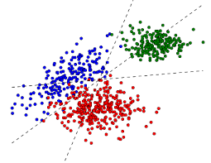
Goals
One multi-classification model which accurately classifies a url as benign, phishing or malicious
Efficient, self-reliant model
Understand feature importance
Utilize model as a supplement to existing security defenses
Help automate security operations workflows for url investigation

Slide 9
Machine Learning Approach
Feature sets could include one or more of the following:
URL-based (lexical)
Host-based
Reputation lists
Domain name registration
Domain name resolution
Connection speed
Link popularity
URL source code

Slide 10
Considerations
Risk in connecting to a potentially malicious web page
Ability to building out a full feature set for each url
Availability of url
Anti-forensic measures
Changing TTPs
Reputable sites may host malicious content
Link popularity may be low regardless of url class
Heuristic analysis of client system is ideal – but difficult to capture

Slide 11
Machine Learning Approach
Feature sets:
URL-based (lexical) properties
Term-document matrix (NLP approach)

Slide 12
Data

Slide 13




Data Records
Benign URLs
10,000 (sampled from 25,000+) collected by crawling Alexa top 2500 websites
Reputation check via 70 antivirus scanners on VirusTotal.com
Phishing URLs
10,000 (sampled from 17,000+) from PhishTank
Malicious URLs
10,000 (sampled from 600,000+) from abuse.ch URLHAUS project

Slide 14
Feature Creation

Slide 15
What’s in a url?
https://data.example.com/info/aboutus/reserved=0?color=black&style=light#top
scheme netloc path params query fragment

Slide 16
Feature Set 1
96 numerical or Boolean predictor features created from url and url-parsed strings
Include:
length
character composition
character location
entropy
masquerading
IP address
domains in Alexa top 500 list

Slide 17
Feature Set 1, cont.
Key feature descriptions:
entropy – a Shannon entropy score reflecting the string’s character distribution.
character continuity rate – reflects total length of each alphabetic, digit and special character strings, divided by length of url
number of masques – count of letter + digit + letter combinations
percent of uppercase / percent of lowercase letters – reflects the percent of these characters against all alphabet characters in given string
is domain in Alexa top 500? – each domain was checked against the current Alexa top 500 website list.

Slide 18
Feature Set 2
NLTK WordPunctTokenizer() method applied to each url string
Results stored in new feature ‘tokenized_url’
Example: https://www.google.com
>>> https, ://, www, ., google, ., com
No further processing required at this time

Slide 19
Exploratory Data Analysis

Slide 20
Malicious URLs – Key Findings
Approximately 50% of the urls in our dataset have an IP address in lieu of a domain
Urls are shorter on average (44.9 characters) than benign (57.4) or phishing (89.1) and have shorter token lengths (3.0 versus 3.4 and 4.1)
On average, these urls have the highest entropy score, 1.072, in comparison to phishing urls (.778) and benign (.576)
Example urls (altered for safety):
hxxp[:]//48.218.61.11:33553/Moxi.m
hxxps[:]//pastebin.com/raw/7MjG2xsJ
hxxp[:]//www.formations-manox.org/fr/wp-admin/Scan/

Slide 21
Phishing URLs – Key Findings
Phishing urls have the longest urls on average, the longest netloc and domain sections. Also the most likely to have one or more subdomains
The urls have a greater percentage of special characters (29.3% versus 16.2 and 23.2% for malicious and benign urls)
Path sections are on average slightly shorter than benign urls and have a greater propensity for single character paths
Path sections have on average a higher number of masques (.468 versus .257 and .109)
Example url (altered for safety):
hxxp[:]//store.ebay.de.roomyb.com/?ebay.de/signin&amp;usingssl=1&amp;puserid=&amp;co_partnerid=2&amp;siteid=77&amp;ru=https:/contact.ebay.be/ws/ebayisapi.dll?m2mcontact&amp;item=164305393996&amp;ul_noapp=true&amp;self=howill99&amp;redirect=0&amp;qid=273594504301

Slide 22
Inferential Statistics

Slide 23
Inferential Statistics – Feature Set 1
Pairwise Correlation Analysis
a significant number of highly correlated features
73 pairs of features have correlation scores of 80+%
Predictor v Target Correlation Analysis
Numeric-based domain and netloc features most highly correlated with target feature
May be reflective of IP addresses in malicious urls
Notes:
I completed a Pairwise correlation analysis between the predictor features.
73 pairs of features have correlation scores of 80+
It’s not surprising since several lexical properties overlap – for ex length of url string and length of any particular url segment. Also – I calculate the same lexical properties for the netloc section of each url, as well as the domain section (which is part of the netloc section).

Slide 24
Machine Learning

Slide 25
Build and test machine learning models
Lexical Feature Set
URL Tokens
Prep
Remove categorical features
Normalization
Train
Parameter/Classifier tuning
Test
Predict on test data
Analyze scores
Analyze scores
Prep
Tokenization
Build Term-document matrix
Train
Parameter/Classifier tuning
Analyze scores
Test
Predict on test data
Analyze scores

Slide 26



Model Evaluation Metrics
Classification Outcome | Description
True Positive (TP) | Model correctly predicts the positive class. E.g. An actual malicious url is classified as malicious.
False Positive (FP) | The model incorrectly predicts the positive class. E.g. An actual benign url is misclassified as malicious.
True Negative (TN) | The model correctly predicts the negative class. E.g. An actual benign url is not classified as malicious.
False Negative (FN) | The model incorrectly predicts the negative class. E.g. An actual malicious url is not classified as malicious.

Slide 27
Model Evaluation Metrics, cont.
Log Loss - An important classification metric based on probabilities. Log Loss quantifies the accuracy of a classifier by penalizing false classifications. A good metric for comparing models, with lower log loss values meaning better predictions.
Accuracy - Fraction of the total samples that were correctly classified as benign, phishing or malicious. Overall accuracy of the model.
Classification Report
Precision: The fraction of predictions as a positive class that were actually positive (TP/(TP + FP)).
Recall: The True Positive Rate: the fraction of all positive samples that were correctly predicted as positive by the classifier (TP/(TP + FN))
F1: A weighted averaged of the precision and recall scores, where an F1 score of 1 means it is 100% accurate. (2TP/(2TP + FP + FN))
Our primary goal is to accurately classify phishing and malicious url links, attaining high true positive rates and low false negative rates. Therefore, recall scores for phishing and malicious urls are highly valuable.

Slide 28
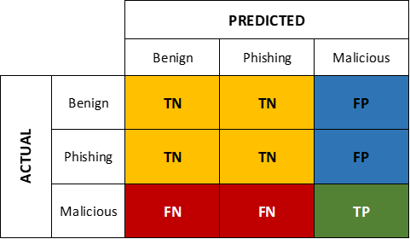
Model Evaluation Metrics, cont.
Confusion Matrix
Confusion matrices allow us to visualize
TP / TN / FP / FN scores for each class.
Confusion matrices for multi-class problems are not straight-forward. For example, in this matrix, True positive classifications scores for malicious urls are obvious.
Other measurements like TN, FP, FN may be derived with manual calculations.

Slide 29
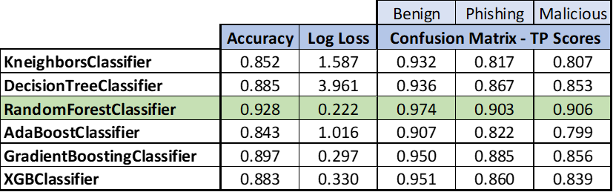
Feature Set 1 – Baseline Scores
The Random Forest Classifier outperforms other classifiers

Slide 30
Feature Set 1 – Random Forest Classifier
Normalization on features improves performance slightly. Parameter tuning does not enhance the model.

Slide 31
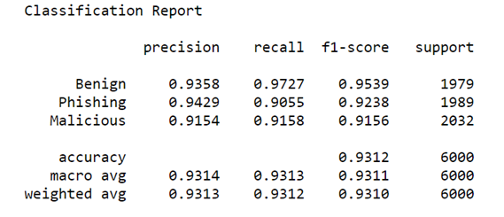
Feature Set 1 – Classification Report

Slide 32
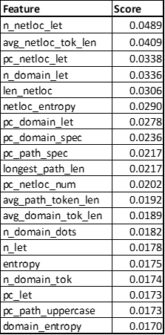
Feature Set 1 – Feature Importance
Domain and netloc features predominate in feature importance scores for our Random Forest Classifier.

Slide 33
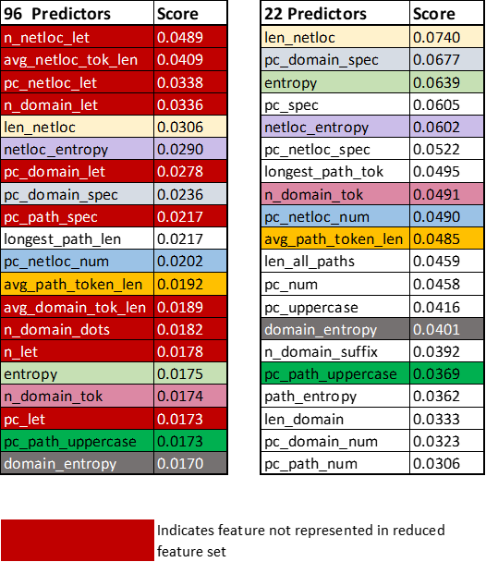
Feature Set 1 – Reduced from 96 >>> 22
Feature selection based on prior feature importance and pairwise correlation
Model accuracy scores did not improve
We still have a high proportion of domain/netloc features in feature importance scores, but new features appear and features like entropy and the percent of special characters move up significantly in the importance list
Multicollinearity does not negatively affect a Random Forest Classifier. Retain full feature set.

Slide 34
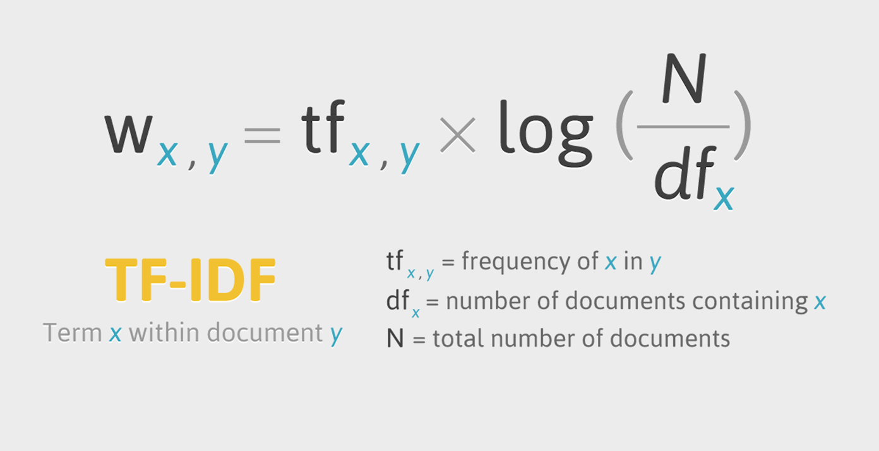
Feature Set 2 – Machine Learning
NLTK WordPunctTokenizer() method applied to each url string to acquire tokens - e.g. http, ://, www, ., google, ., com
Corpus – the collection of all tokens
TF-IDF – The vectorization method to transform tokens into vector representations
Each url token is assigned a number
proportional to frequency in url string and
inversely proportional to number of url
strings in which it occurs
source: https://class101.dev/images/thumbnails/tf-idf.png

Slide 35
Feature Set 2 – Machine Learning
Scikit-learn TfidVectorizer
Uses an estimator to count the occurrence of tokens (TF)
TfidTransformer normalizes these counts by the inverse document frequency (IDF)
Result: a sparse matrix with doc, term, tf-idf score.
Matrix with one row per url
Columns represent each unique token in the entire corpus

Slide 36
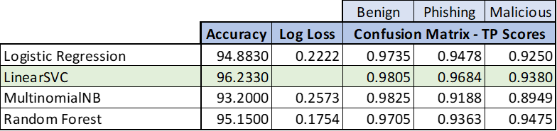
Feature Set 2 – Baseline Scores
Each of these classifiers outperforms models built with Feature Set 1.

Slide 37
Feature Set 2 – Parameter Tuning, Validation
LinearSVC, Logistic Regression and Random Forest Classifier tuned
StratifiedKFold validation of scores
preserves the percentage of samples for each class
mean accuracy of 96.21 for each, sd between .0015 - .0021

Slide 38
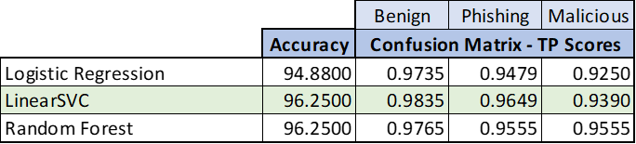
Feature Set 2 – Final Scores
LinearSVC and Random Forest Classifier tie on the overall accuracy score
LinearSVC has the highest True Positive detection rate for benign and phishing urls
Random Forest Classifier has the best True Positive scoring for malicious urls
Notes:
…

Slide 39
Feature Set 2 – Final Scores
 | LinearSVC
 | precision | recall | f1-score
benign | 0.9825 | 0.9835 | 0.9830
phishing | 0.9286 | 0.9649 | 0.9464
malicious | 0.9781 | 0.9391 | 0.9582
 | Random Forest
 | precision | recall | f1-score
benign | 0.9839 | 0.9765 | 0.9802
phishing | 0.9371 | 0.9554 | 0.9462
malicious | 0.9671 | 0.9555 | 0.9613
 | Logistic Regression
 | precision | recall | f1-score
benign | 0.9659 | 0.9735 | 0.9697
phishing | 0.9136 | 0.9479 | 0.9304
malicious | 0.9691 | 0.9251 | 0.9466
Best Recall Scores:
The LinearSVC model will accurately classify 98.35% of actual benign urls as benign, and 96.49% of actual phishing urls as phishing.
The Random Forest Classifier model will accurately classify 95.55% of actual malicious urls as malicious.
Precision | TP / (TP + FP) | The fraction of predictions as a positive class that were actually positive.
Recall | TP / (TP + FP) | The fraction of all positive samples that were correctly predicted as positive by the classifier.
F1 | 2TP / (2TP + FP + FN) | A combined measure of both precision and recall.

Slide 40
Feature Set 2 - Stacking
Ensemble learning technique which combines multiple classification base models with a meta-classifier
Base-level models trained on the complete training set
Meta-classifier trained on prediction outputs of base models
Base models: Logistic Regression, Random Forest Classifier & LinearSVC
Logistic Regression meta-classifier
Slight improvement in scores

Slide 41
Feature Set 2 - Stacking
Only the accuracy score and recall score for phishing urls improves.

Slide 42
Summary

Slide 43
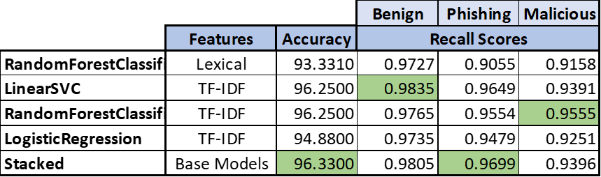
Machine Learning Summary
Our feature set leveraging natural language processing achieved the best overall scores
LinearSVC and RandomForest Classifiers trained on matrices with url token TF-IDF scores tied with an overall accuracy score of 96.25
LinearSVC model returned the highest recall scores for benign and phishing urls
Random Forest Classifier model returned the highest score for predicting positive malicious urls
We achieved superior performance with underlying features rely solely on url strings and built ‘in-house’
Stacking classifiers slightly improved overall performance, but not for detecting malicious urls

Slide 44
Models in Production

Slide 45
Models in Production
Goals:
URL classification model to assist in the investigation of events involving a url
URL classification model for defense against phishing and malicious urls
URL Investigation
URL has passed existing security defenses
Leverage model in an automated, operations workflow that analyzes url links involved in suspicious emails and/or web traffic
Employ a model with high recall scores in classifying phishing and/or malicious urls
Utilize model predictions to inform security personnel or user and/or prevent further actions

Slide 46
Next Steps

Slide 47
Next Steps
Feature Set 1 – Improve model performance by adding additional features (lexical or non-lexical)
Feature Set 2 – For Stacking Model, switch out base classifiers with others (GaussianNB and Decision Tree), to potentially improve overall scores.
Build separate models to classify one URL type

Slide 48
The End

